Slide 1
Open Targets: integrating genetics, omics and chemical data for drug discovery
BRIDGE Translational Excellence Programme
University of Copenhagen
August 21^{sh} 2019
Denise Carvalho-Silva
Maya Ghoussaini
Open Targets
Wellcome Genome Campus
United Kingdom

Slide 2
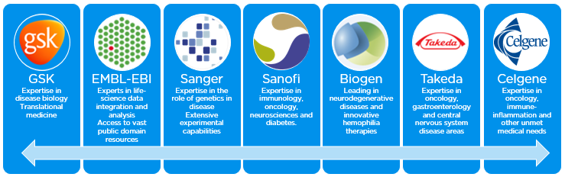
Open Targets
A partnership to transform drug discovery
Founded in 2014
Founding partners
2018
2016
2017
2018
Systematic identification and prioritisation of targets

Slide 3








Knowledge cycle
Public data
Experimental projects
Bioinformatics projects
DATA
GENERATION
DATA
INTEGRATION
Therapeutic hypothesis

Slide 4

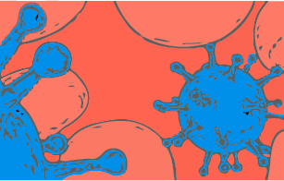

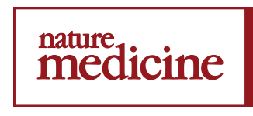

Data generation: therapeutic areas
2 complete projects
3 complete projects
3 manuscripts on bioRxiv
9 ongoing projects
7 ongoing projects
5 ongoing projects
1 publication (2019)
1 publication (2019)

Slide 5
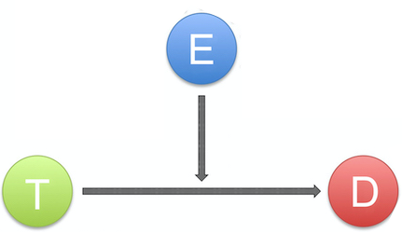
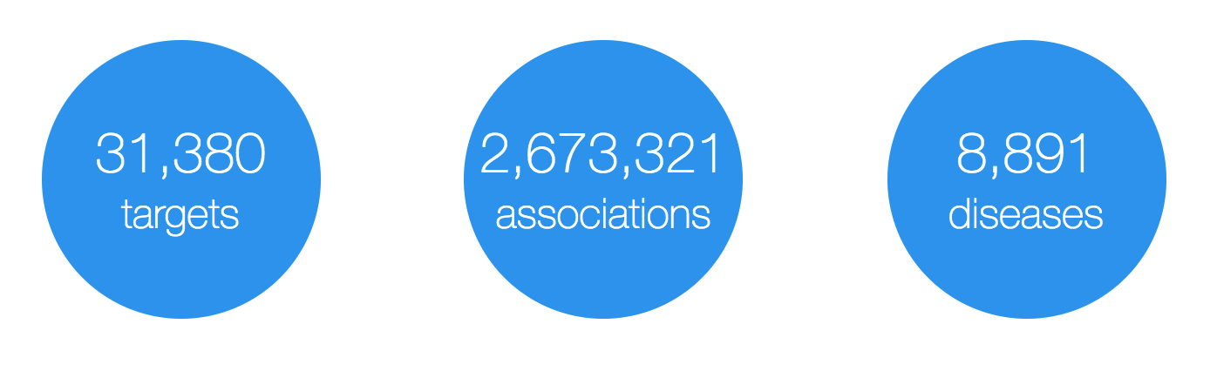
Open Targets Platform: data model
Evidence
(variants, drugs, literature, etc)
Target
(protein and non-protein coding genes)
Disease
(rare and common)
https://www.targetvalidation.org

Slide 6
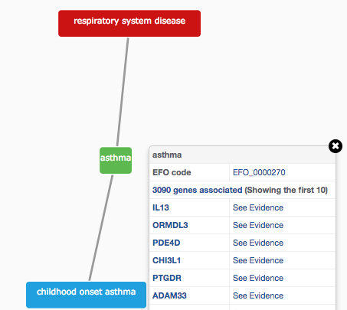
How do we describe our diseases?
Modified version of Experimental Factor Ontology (EFO)
Controlled vocabulary (Coeliac versus Celiac)
Hierarchy (relationships)
Promotes consistency
Increases the richness of annotation
Allow for easier and automatic integration
10K
diseases

Slide 7
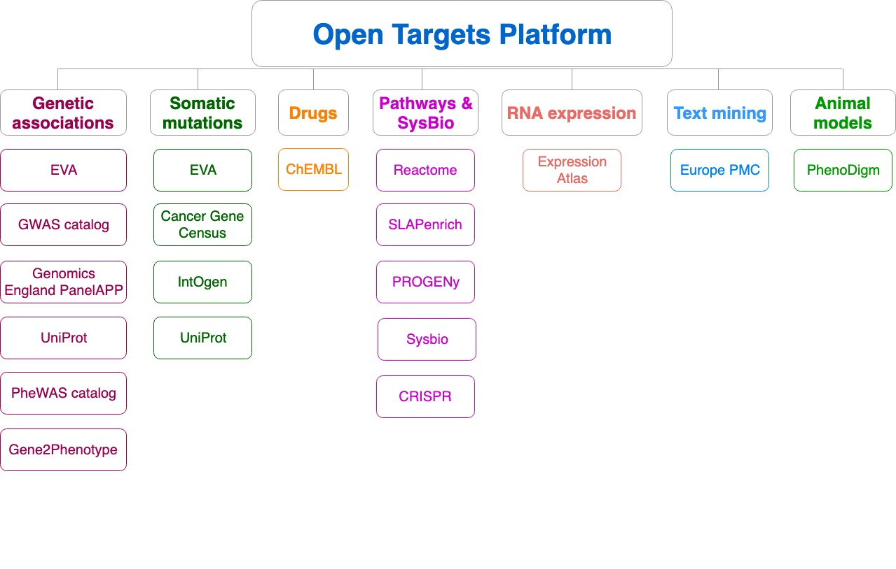
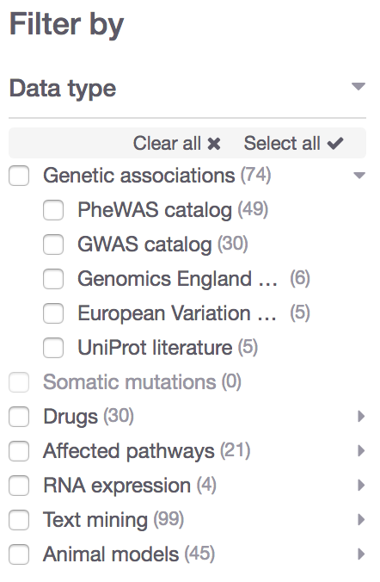
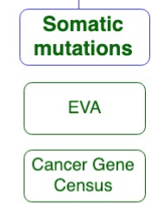
Evidence for target-disease associations
Data type
Data source
https://docs.targetvalidation.org/data-sources/data-sources

Slide 8

What can you do with the Open Targets Platform?
Target-disease associations (+ evidence + score)
https://www.targetvalidation.org/evidence/ENSG00000141510/EFO_0000228
Target annotations
http://www.targetvalidation.org/target/ENSG00000141510
Disease annotations
http://www.targetvalidation.org/diseaset/EFO_0000228

Slide 9
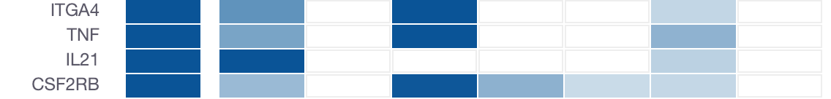
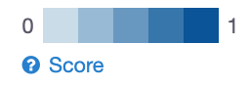
How well supported are the associations?
Association score to convey confidence
More evidence → stronger association score
Different evidence are scored and weighted in different ways
Overall score
Genetic
Somatic
Drugs
Pathways
Expression
Text mining
Animal mod

Slide 10

Computing the score for one evidence
score = f * s * c
f, relative occurrence of a target-disease evidence
s, strength of the effect of the variant
c, confidence of the observation for the target-disease evidence
f = sample size (cases and controls)
s = predicted functional consequence (VEP)
c = p value reported in the paper
(Factors affecting the relative strength of GWAS Catalog evidence)
https://docs.targetvalidation.org/getting-started/scoring

Slide 11
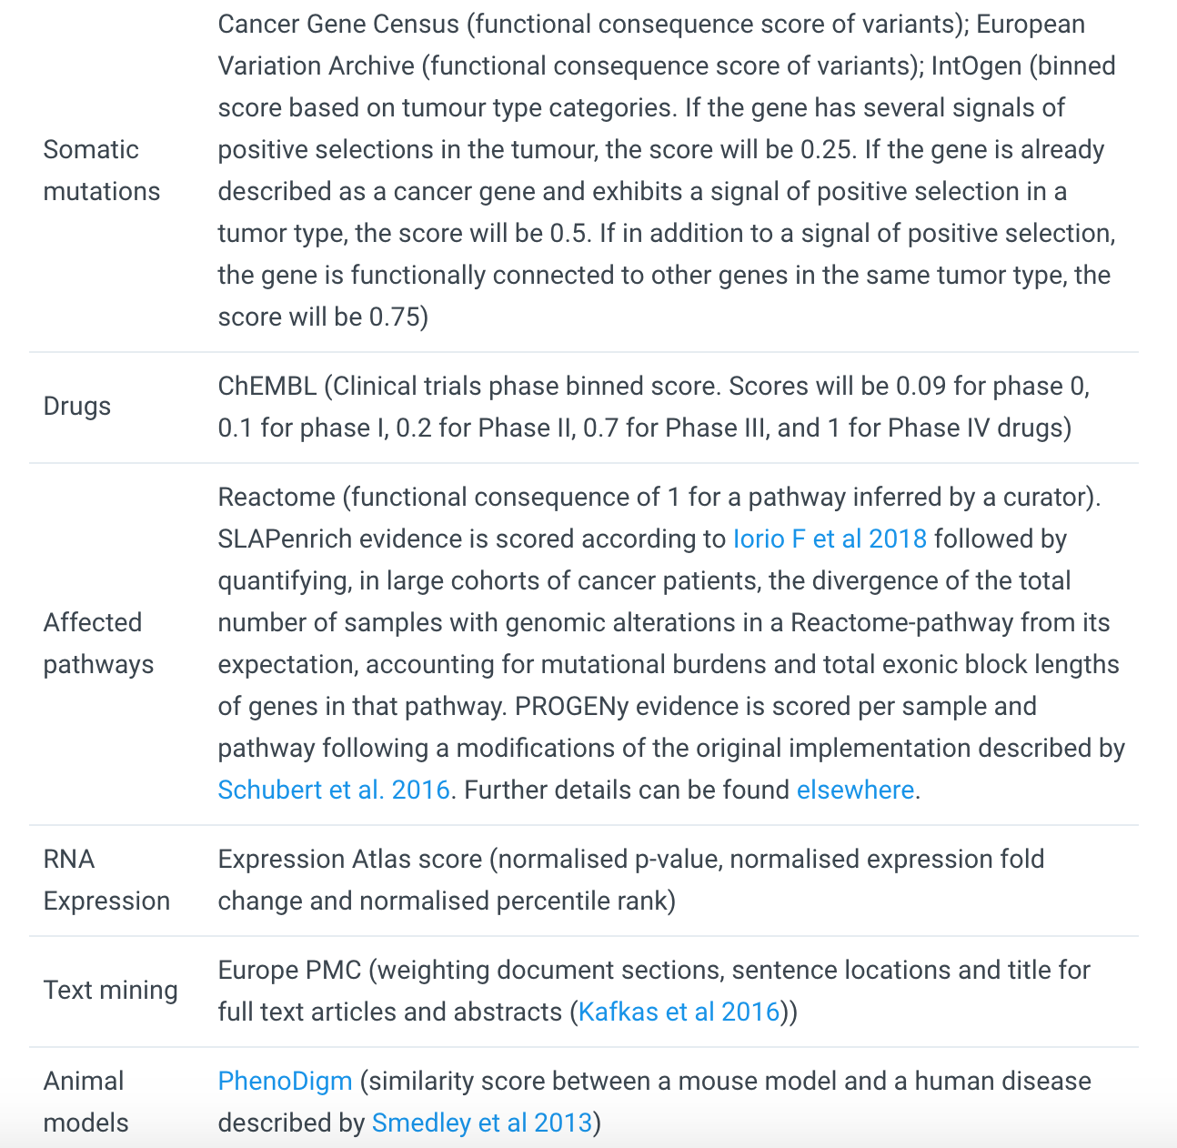
https://docs.targetvalidation.org/getting-started/scoring
Factors affecting the relative strength of the evidence

Slide 12
Evidence score to overall score
Statistical integration, aggregation and scoring
1) Evidence score (e.g. one SNP from a GWAS paper)
2) Data source score (e.g. all SNPs from the GWAS catalog)
3) Data type score (e.g. all sources of Genetic associations)
4) Overall association score
https://docs.targetvalidation.org/getting-started/scoring

Slide 13
What can you do with the Open Targets Platform?
Target-disease associations (+ evidence + score)
https://www.targetvalidation.org/evidence/ENSG00000141510/EFO_0000228
Target annotations
https://www.targetvalidation.org/target/ENSG00000141510
Disease annotations
https://www.targetvalidation.org/diseaset/EFO_0000228

Slide 14
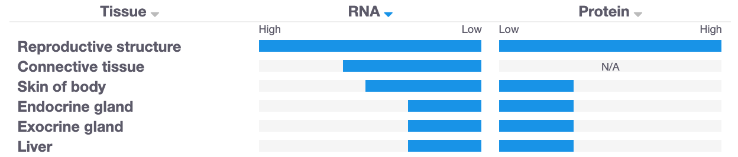
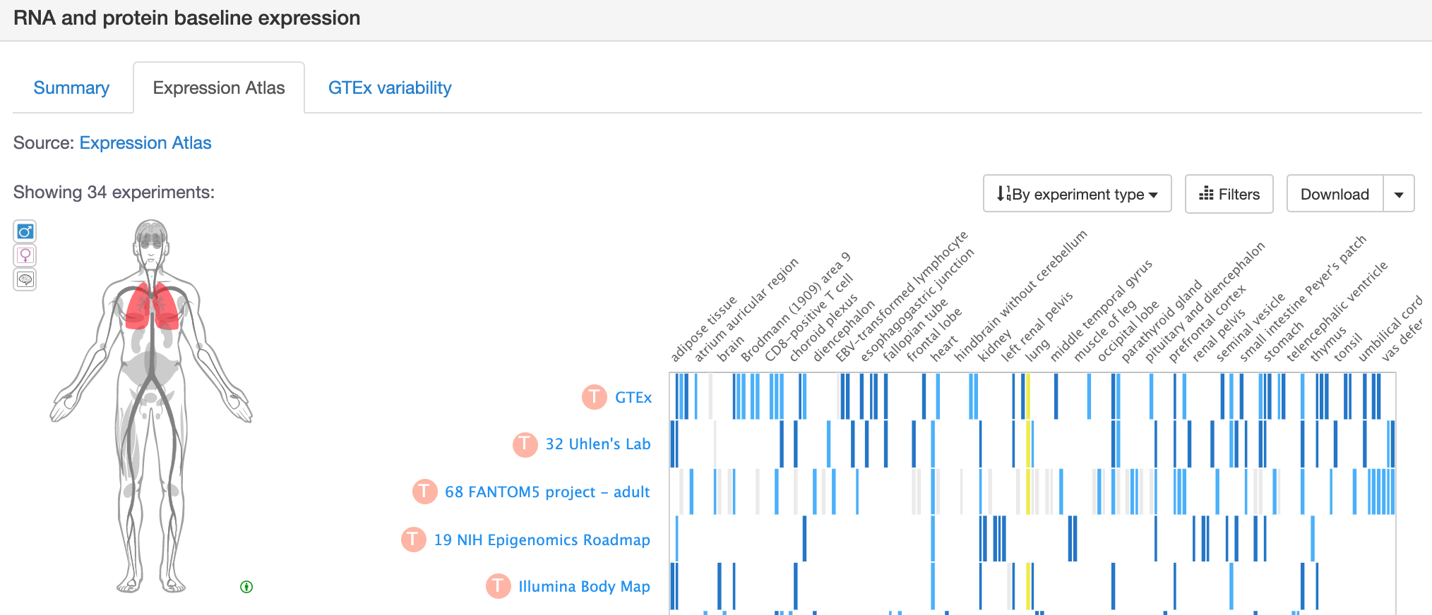
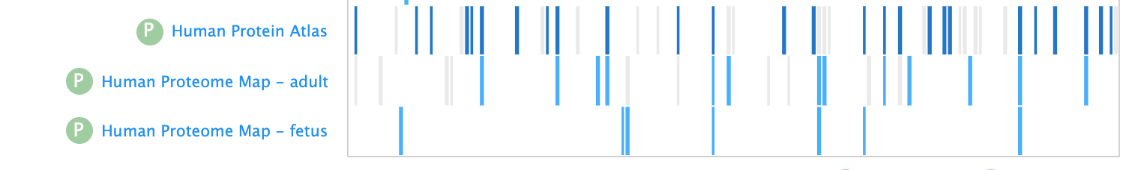


Is my target expressed in the relevant tissue?
Target annotations

Slide 15
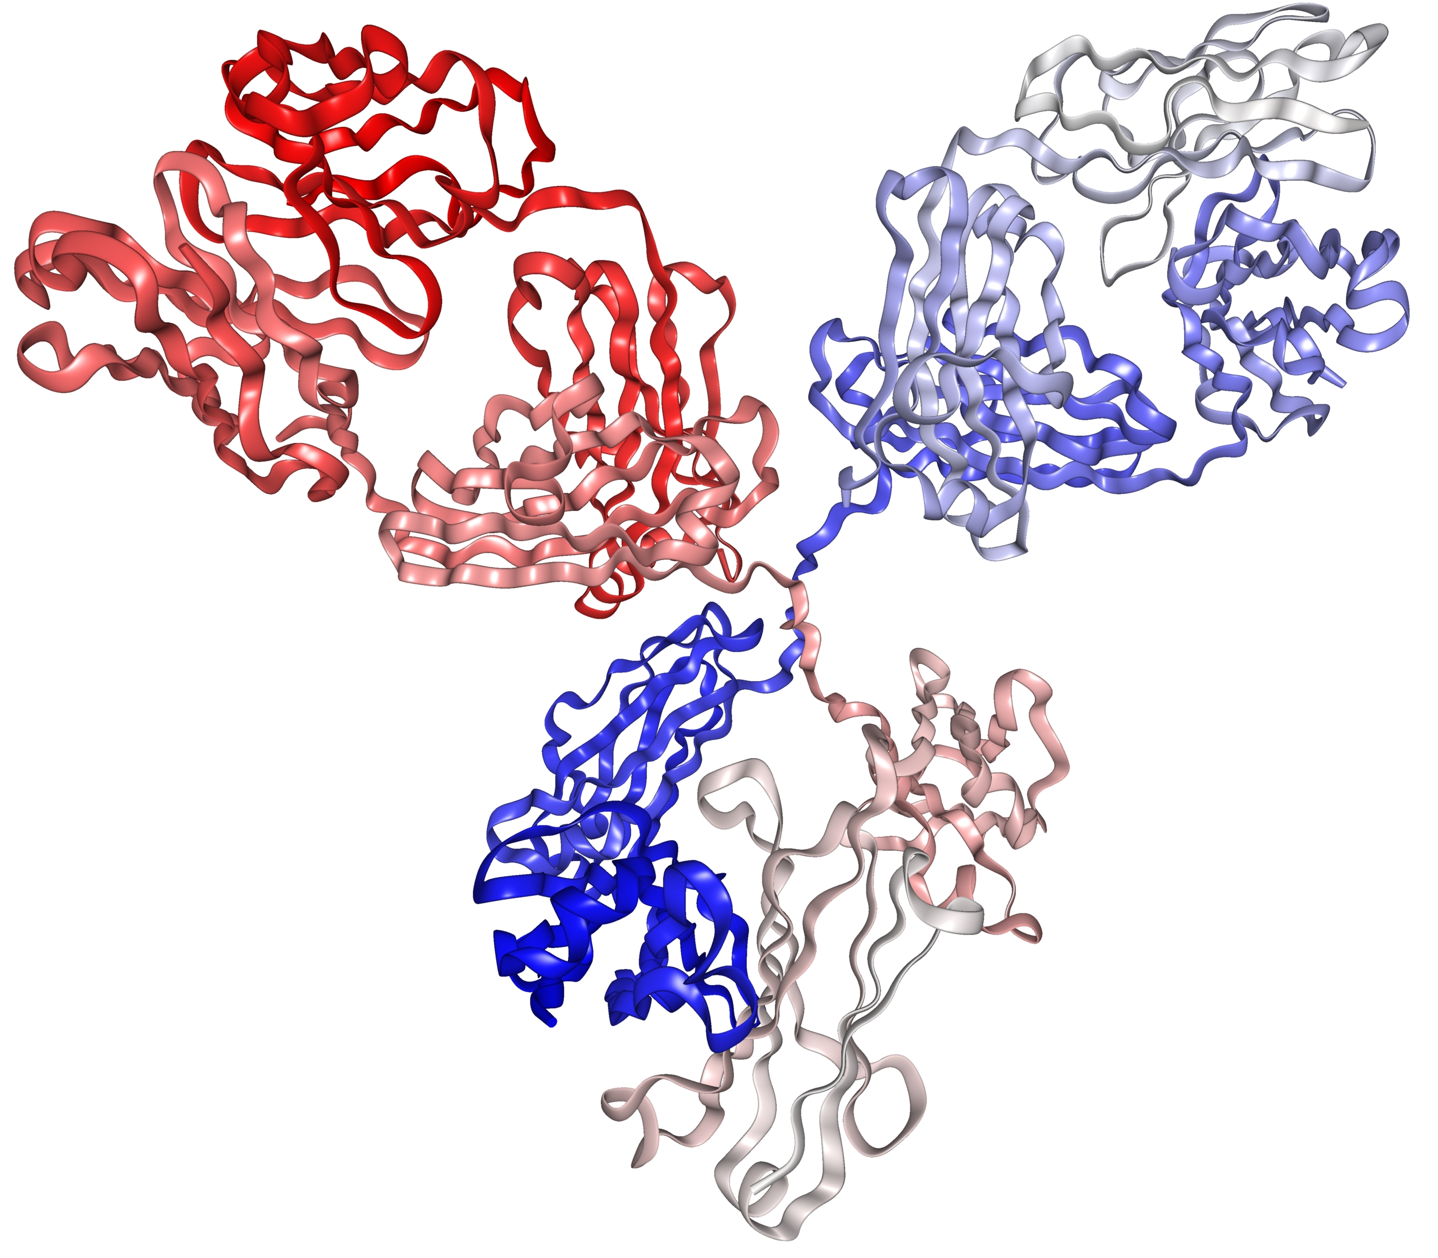
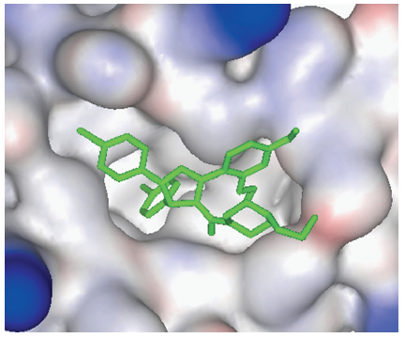
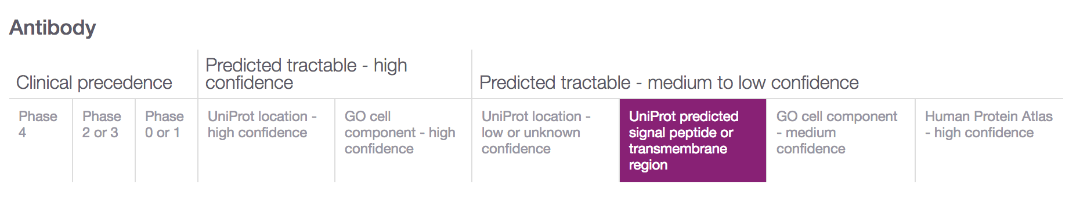
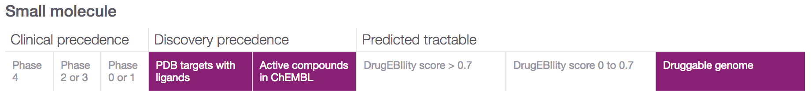
Is my target tractable?
DOI:10.1517/17460441.3.4.391
https://www.immunology.org/structure-antibody-1972
Target annotations

Slide 16
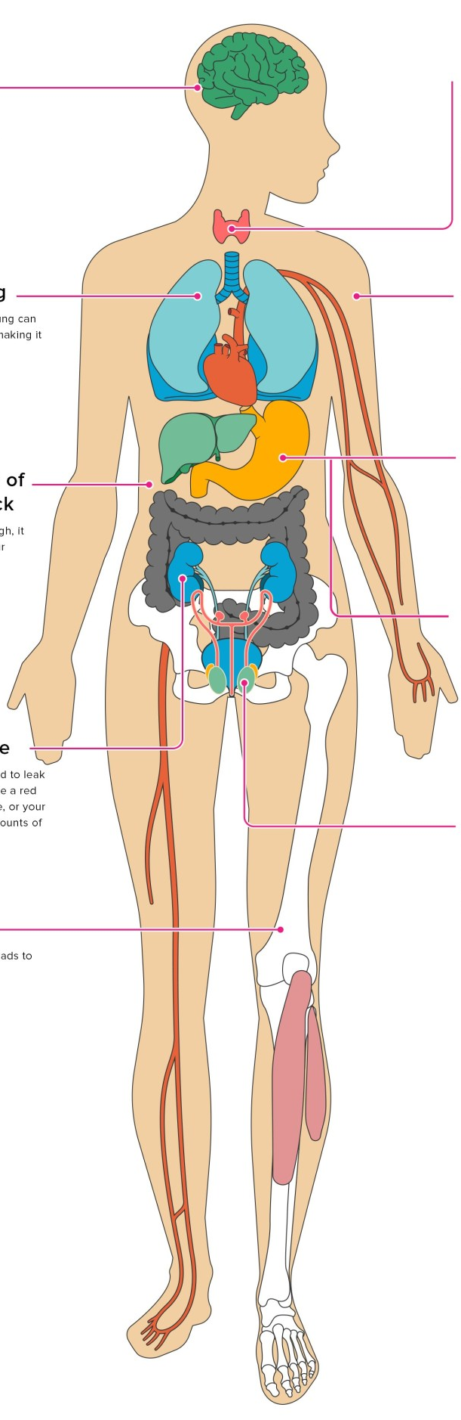
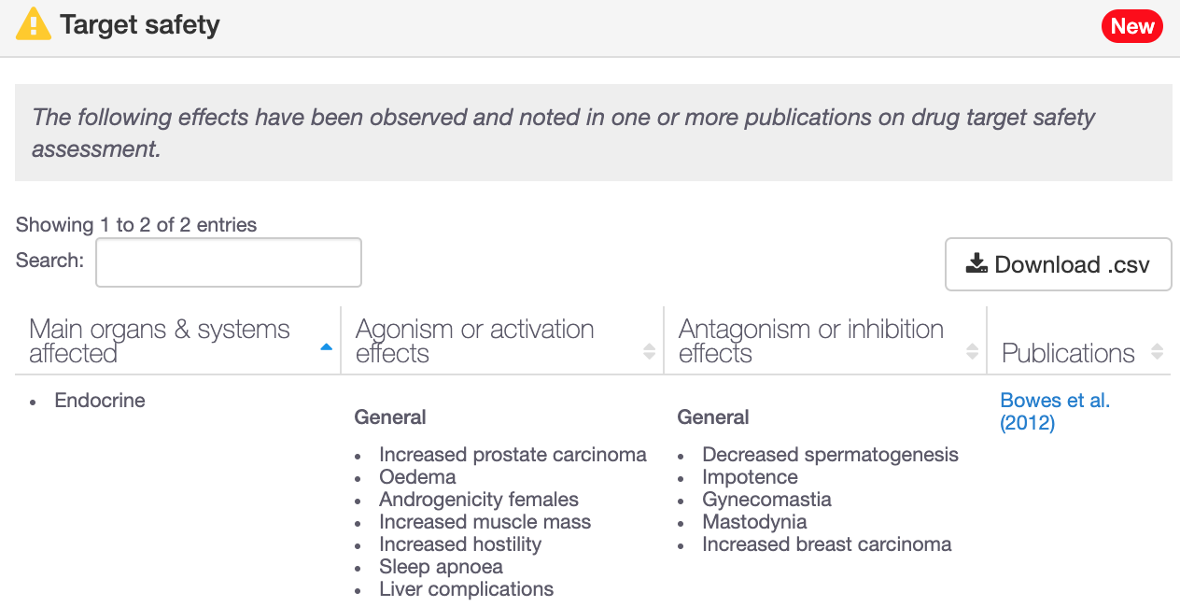
Is my target safe to be modulated?
193 genes with target safety information
Drowsiness
Increased heart rate
Hepatotoxicity
Target annotations

Slide 17
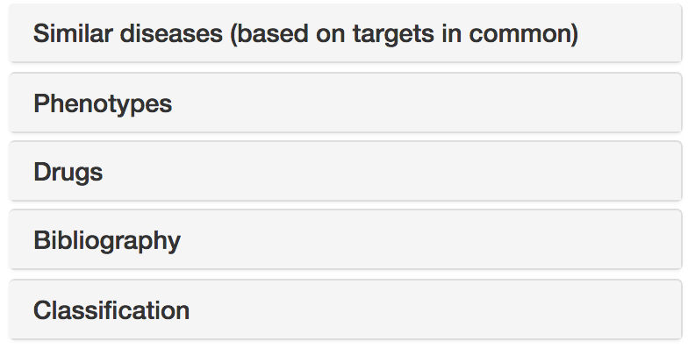




Disease annotations
Disease profile page
https://docs.targetvalidation.org/getting-started/getting-started/disease-profile

Slide 18
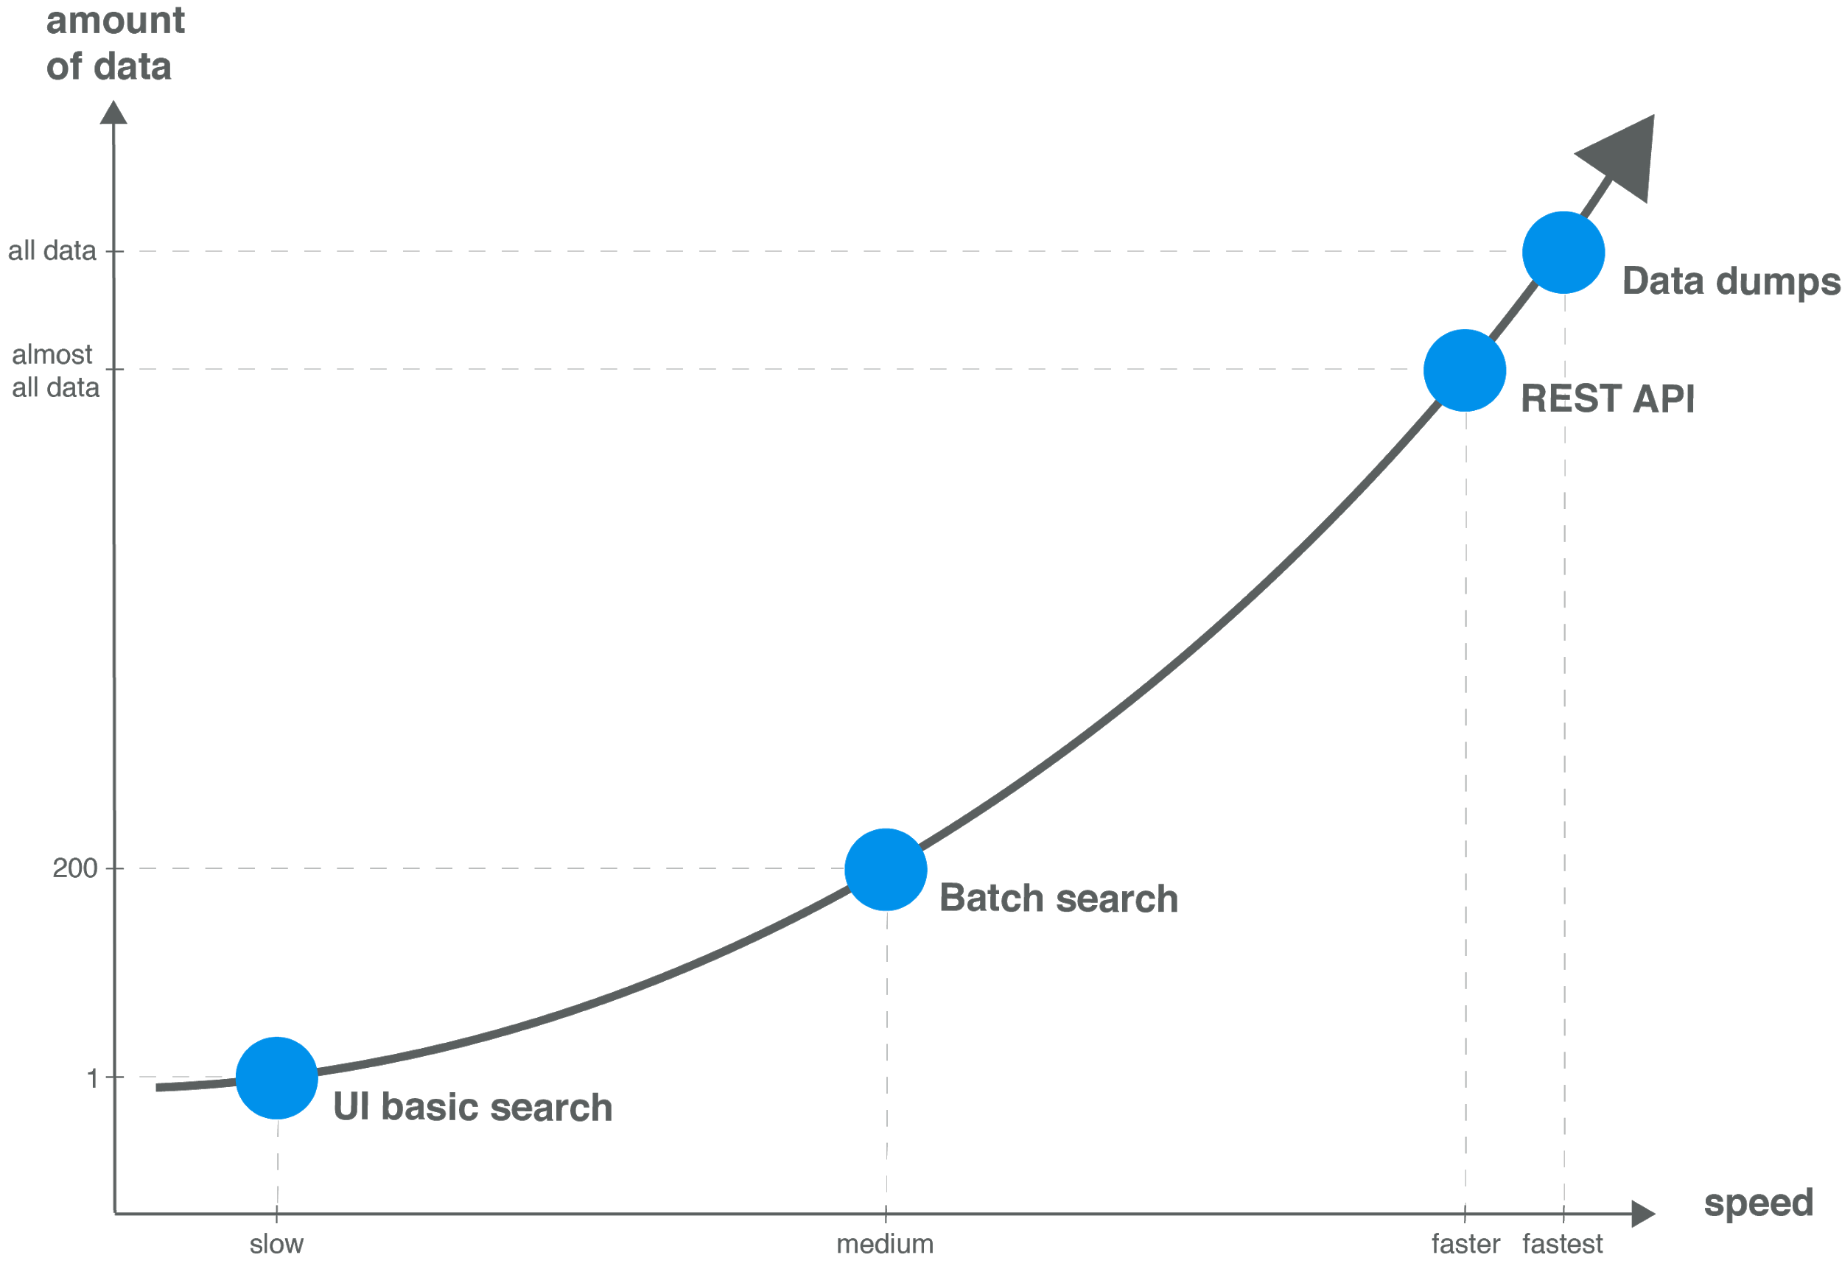
Modes of access → data volume

Slide 19
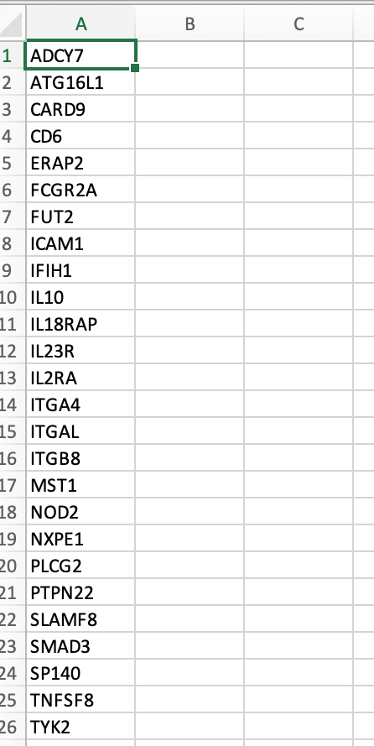
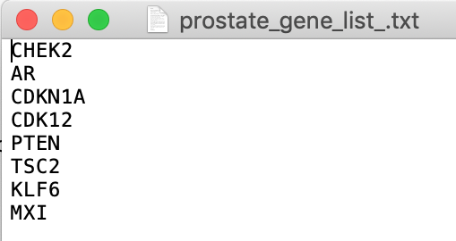
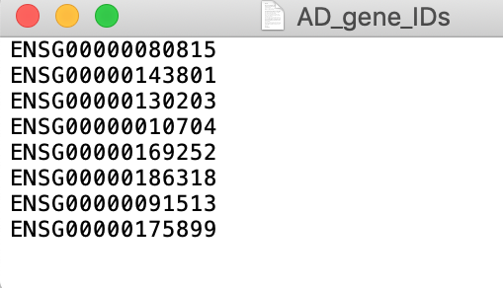
Have you got a list of targets?
Using the web interface, choose
batch search or
”Your target list” filtering

Slide 20




Open Targets Platform REST API*
Server
https://platform-api.opentargets.io/v3/platform/
Endpoint
public/association/filter
Parameters
?target=ENSG00000163914&size=10000&fields=target.id&fields=disease.id
Open Targets Python client **
*
https://docs.targetvalidation.org/tutorials/rest-api
**
https://docs.targetvalidation.org/tutorials/python-client

Slide 21
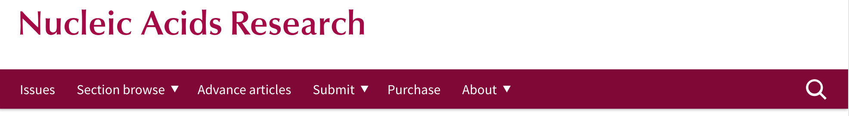
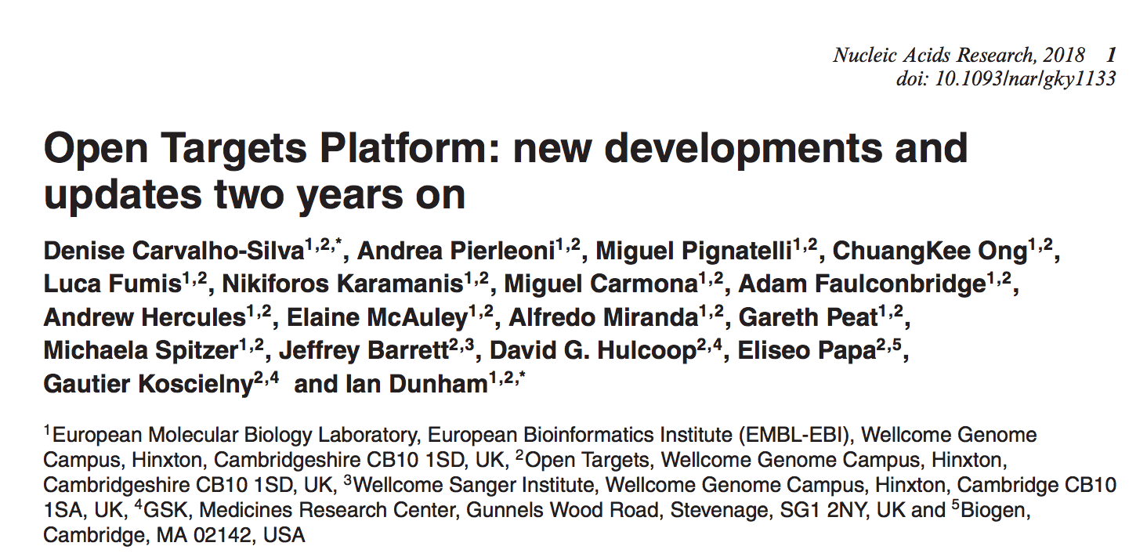
Want to learn more?
http://bit.ly/cite-us

Slide 22
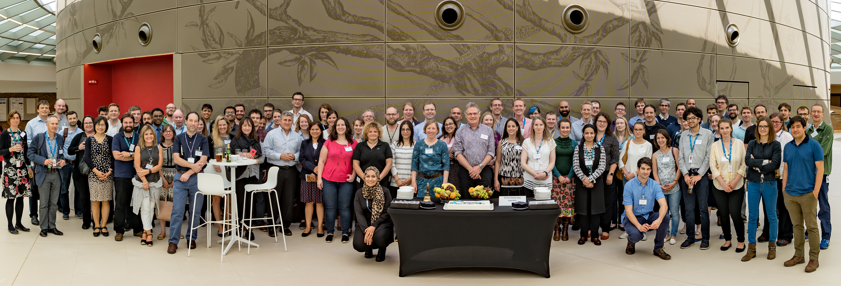







Acknowledgements

